Slide 1
Plasma Citrulline in Relation to Clinical Outcomes in the GLND Trial
Secondary analyses from the GLND trial ‘Efficacy and Mechanisms of GLN dipeptide in the SICU’
BIOS 745
Jie Chen
Dec 7, 2012

Slide 2
Background for GLND Trial
In surgical intensive care unit (SICU), patients may experience glutamine (GLN) depletion when they have surgery because of critical illness
GLN is an amino acid essential for maintaining the immune state during periods of severe stress
GLN deficiency may be associated with morbidity and mortality
However, conventional parenteral nutrition does not contain GLN and thus does not prevent GLN depletion in the catabolic state
Notes:
require parenteral nutrition because they

Slide 3
Goal of the GLND RCT:
To assess if GLN-supplemented PN improves metabolic and clinical outcomes in critically ill patients in SICU
GLND Trial:
A multicenter, double-blind, randomized, controlled phase III trial
Study population:
150 patients aged 18-90 yrs in SICU
Parallel Design
Intervention: AG-PN (alanyl-glutamine dipeptide supplemental parenteral nutrition)
Control: STD-PN (standard glutamine-free parenteral nutrition)

Slide 4
Outcome Measures:
Hospital mortality, primary outcome
in-hospital mortality, 28-day mortality, 6-month mortality, nosocomial infection
Some important indices of illness severity:
APACHE II Score
SOFA Score
Secondary analyses: Is plasma citrulline at SICU admission related to clinical outcomes [low citrulline may be associated with poor prognosis)

Slide 5
Results
Plasma Citrulline Level
Critically ill patients have a low citrulline concentration ≤ 10 uM
Normative reference range for adults: 11-50 uM
Prevalence of citrulline depletion (<11uM) at GLN enrollment:
58/146 = 39.7%
95% CI [32.2% , 47.8%]

Slide 6
Test association between baseline citrulline and each outcome variable
Logistic Regression
between baseline Citrulline vs. each of the following outcomes
e.g.:
Proc logistic descending;
Class citcat; ** citcat – quartile groups;
Model hospital_death=citcat/rl;
Run;
Predictor | Outcome | Wald chi-square p-value
Baseline Citrulline | In-hospital mortality | 0.6009
 | 28-day mortality | 0.2657
 | 6-month mortality | 0.1762
 | APACHE II score | 0.0287
 | Admission SOFA | 0.0337

Slide 7
Baseline citrulline vs. Hospital Mortality
Cochran-Armitage Trend Test
e.g.:
proc freq data=four;
tables CITcat*hospital_death/
nopercent norow trend;
run;
Baseline Citrulline Level |  | Survivors |  | Non-Survivors |  | OR | CA Trend Test p-value
 |  | x/total | % | x/total | %
1st Quartile | [0,8) uM | 30/123 | 24.4% | 7/23 | 30.4% | 1.69 | 0.94
2nd Quartile | [8,12) uM | 41/123 | 33.3% | 3/23 | 13.0% | 0.53
3rd Quartile | [12,17) uM | 23/123 | 18.7% | 9/23 | 39.1% | 2.84
4th Quartile | [17,∞) uM | 29/123 | 23.6% | 4/23 | 17.4% | 1.00
P-value=.94 =>
Test for trend in binomial proportions across quartile groups
Notes:
Cochran-Armitage Trend Test is used in categorical data analysis when the aim is to assess for the presence of an association between a variable with two categories and a variable with k categories.

Slide 8
APACHE II Score at randomization
SOFA score (median) at randomization
Baseline Citrulline Level |  | Low Ap0 (< =15) |  | High Ap0 (> 15) |  | OR | Cochran-Armitage Trend Test p-value
 |  | x/total | % | x/total | %
1st Quartile | [0,8) uM | 23/70 | 32.9% | 14/76 | 18.4% | 0.40 | 0.09
2nd Quartile | [8,12) uM | 19/70 | 27.1% | 25/76 | 32.9% | 0.86
3rd Quartile | [12,17) uM | 15/70 | 21.4% | 17/76 | 22.4% | 0.74
4th Quartile | [17,∞) uM | 13/70 | 18.6% | 20/76 | 26.3% | 1.00
APACHE II score and SOFA score: indices of disease severity
Baseline Citrulline Level |  | Low SOFA (≤ 6) |  | High SOFA (> 6) |  | OR | Cochran-Armitage Trend Test p-value
 |  | x/total | % | x/total | %
1st Quartile | [0,8) uM | 23/76 | 30.3% | 14/70 | 20.0% | 0.51 | 0.08
2nd Quartile | [8,12) uM | 25/76 | 32.9% | 19/70 | 27.1% | 0.63
3rd Quartile | [12,17) uM | 13/76 | 17.1% | 19/70 | 27.1% | 1.22
4th Quartile | [17,∞) uM | 15/76 | 19.7% | 18/70 | 25.7% | 1.00

Slide 9
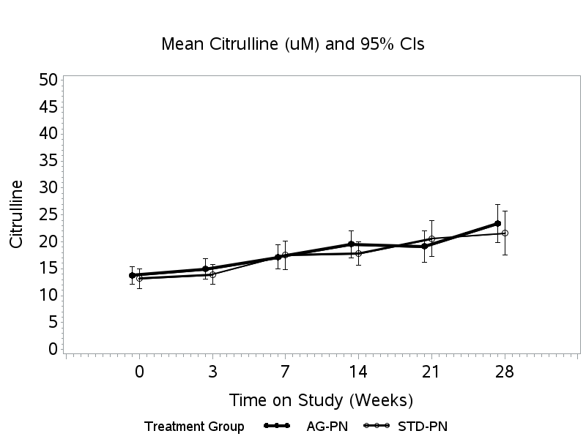
Serial Citrulline Levels by Treatment
Longitudinal data, Linear mixed-effects model
The mean change in citrulline over time does not differ between two treatment groups.
Similar result: Serial Citrulline Level does not differ between Survivors/Non-survivors.
Notes:
proc mixed data=three empirical;
class id hospital_death day;
model citrulline=hospital_death day hospital_death*day;
repeated /sub=id type=cs;
lsmeans hospital_death day hospital_death*day /alpha=.05 cl; *** pdiff ;
ods output lsmeans=xsave.lsm_cit_s_ns;

Slide 10
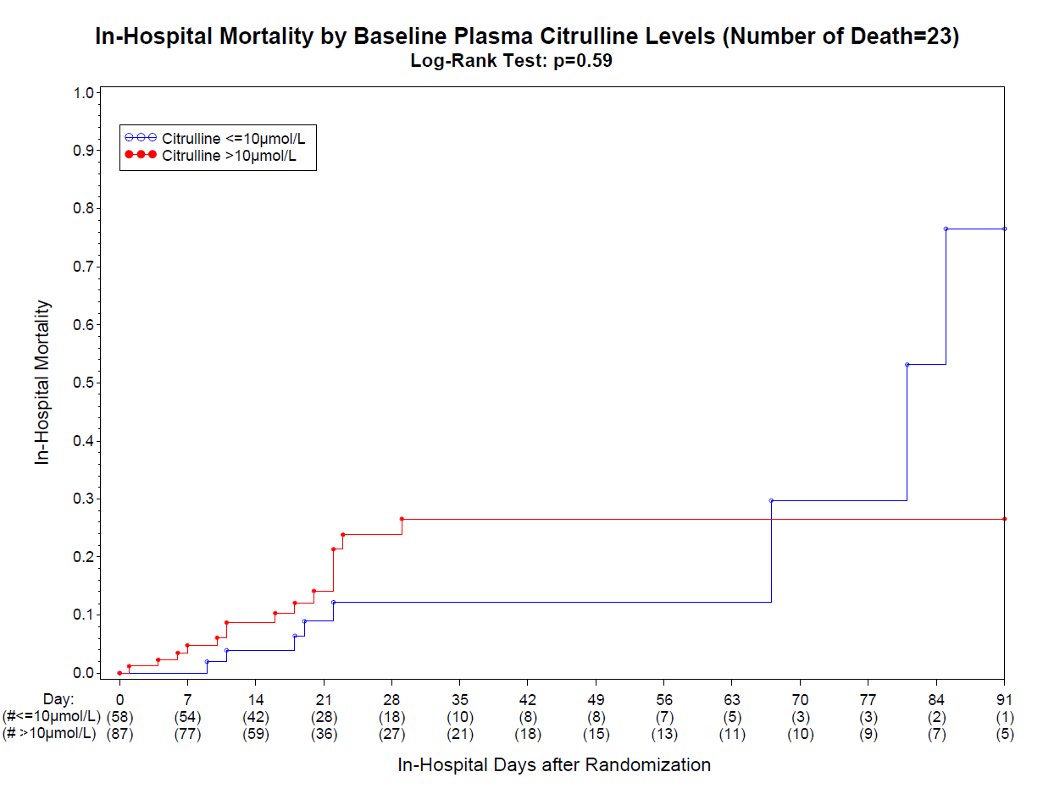
In-Hospital Mortality by Baseline Citrulline
Log-Rank Test
Citrulline
<=10 uM (below reference/normative range)
> 10 uM to 50 uM: Reference range in adults
normal
Sick

